Slide 1



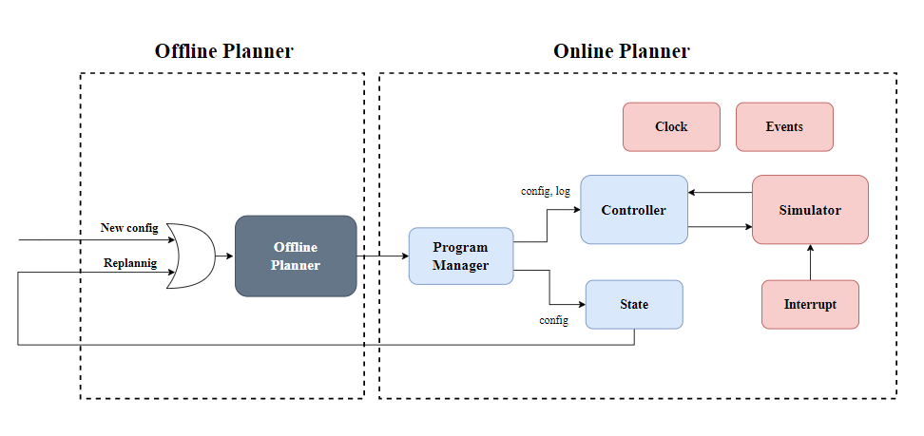
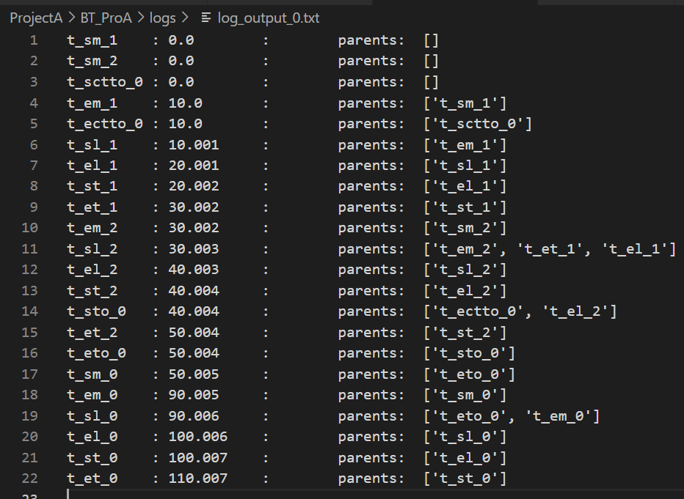
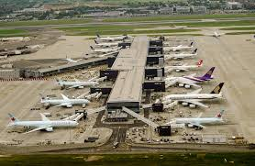
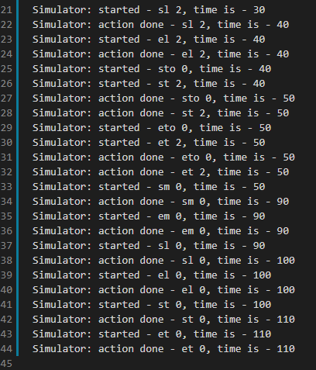
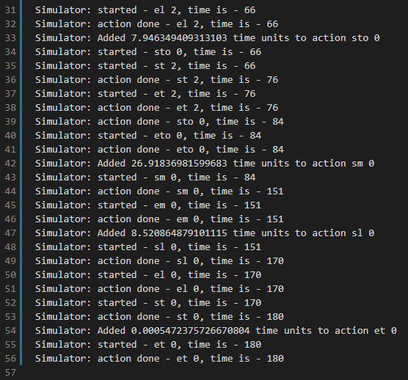
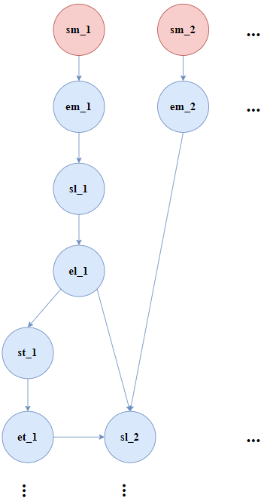
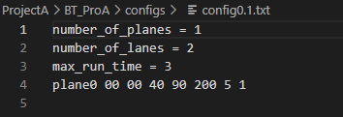
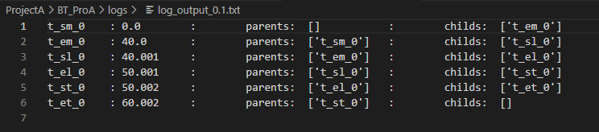
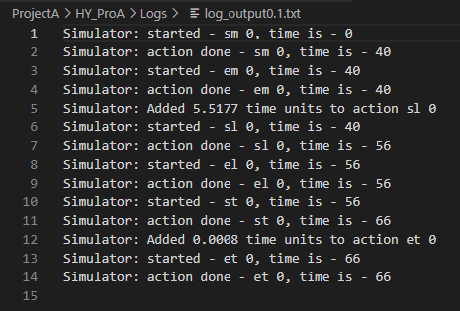
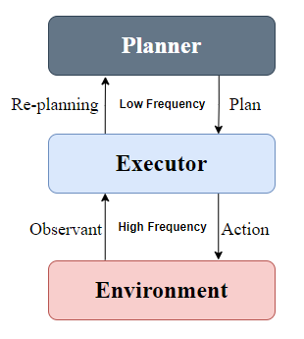
Online Algorithm for Management Takeoffs and Landings
Yoav Cohen and Hodaya Cohen-Adiv, Supervised by Ayal Taitler
Introduction
Block Diagram
Results
An Airport has a lot of operations everyday.
Multiple planes that are simultaneously take off and land.
Operations that depends on other operations.
Unexpected problems create conflicts and may change the day plan.
Airport management is done with a day plan and executing it in REAL TIME.
Offline plan in the form of a table:
Offline Planner – is the Offline Algorithm.
Program manager – is the linking chain between the offline algorithm and the online algorithm. Responsible for creating the different modules and their connections.
Controller – is the control tower. The controller decides on the following actions that will be sent to the environment for execution. The main data structure that it uses is:
STN graph:
The Offline’s output is a STN graph in a table configuration, The controller transforms the table to an a-cyclic directed graph
Online output with no interrupts:
Airport
Project Goal
Online output with interrupts:
Creating an online Algorithm for managing takeoffs and landings
Our algorithm ran the offline plan while dealing with real-time malfunctions and changes.
The algorithm must decide whether the program can run with the different constraints or whether re-planning is needed.
Online output with replanning:
Challenges
New config file
New offline log file
Planning with times and constrains in real time.
Feedback from the online algorithm to the offline algorithm.
STN Graph
Simulator – is simulates the world. The simulator is the executing factor. It takes actions and orders and executes them.
State - Represents the state of the world at any given moment.
Clock - Represents the timeline that is discreetly represented. Is a global module.
Events - A list of signals through which all modules communicate. This is a communication protocol that we've created. Is a global module.
Interrupt - Produces Interrupts that are sent to the simulator. The module is random in two ways:
Frequency of Interrupt.
Interrupt’s duration.
New online log file
General Schema
Future Work
Add more types of interrupts to simulate a more realistic world in a simulation.
Add a GUI - Make the system inactive to the user with which he will be able to track the planes and lanes in real-time.
The Planner is the Offline Algorithm.
The Executor is the Online Algorithm.
The Environment is the testing environment that simulates an airport with interrupts in real-time.

